Slide 1


Slide 2
Problem
Calculate the outcome of compound interest accounts
While reusing previous code

Slide 3


Constrains and Limitations
Reuse Functions for different parts
Cannot import libraries that do all the heavy lifting
Must have a reusable way of exchanging time units
Must all be done in one file

Slide 4


Key Challenges
Compare Simple and Compound Interest
Account to Reach a Target
Compare 2 Compound interest Accounts
Module Regular Deposits
Simulate increase in Compounding Frequency

Slide 5
Features
Uses 1 function to get all the inputs for all parts
Uses 1 function to calculate information for all parts
Minimal use of python libraries only for visual appeal
Uses dictionaries to store the information for the account
Has a User Interface to run any part without restarting

Slide 6
Features
Uses 1 function to get all the inputs for all parts
Uses 1 function to calculate information for all parts
Minimal use of python libraries only for visual appeal
Uses dictionaries to store the information for the account
Has a User Interface to run any part without restarting

Slide 7
Features
Uses 1 function to get all the inputs for all parts
Uses 1 function to calculate information for all parts
Minimal use of python libraries only for visual appeal
Uses dictionaries to store the information for the account
Has a User Interface to run any part without restarting

Slide 8
Features
Uses 1 function to get all the inputs for all parts
Uses 1 function to calculate information for all parts
Minimal use of python libraries only for visual appeal
Uses dictionaries to store the information for the account
Has a User Interface to run any part without restarting

Slide 9
Features
Uses 1 function to get all the inputs for all parts
Uses 1 function to calculate information for all parts
Minimal use of python libraries only for visual appeal
Uses dictionaries to store the information for the account
Has a User Interface to run any part without restarting

Slide 10
Features
Uses 1 function to get all the inputs for all parts
Uses 1 function to calculate information for all parts
Minimal use of python libraries only for visual appeal
Uses dictionaries to store the information for the account
Has a User Interface to run any part without restarting

Slide 11
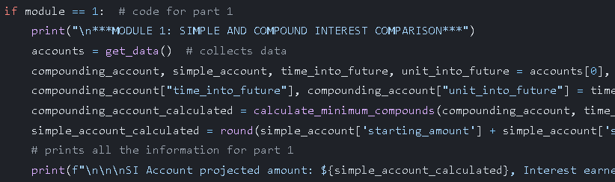
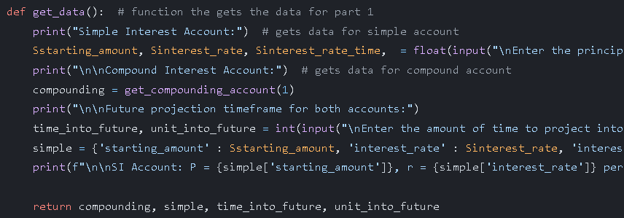
Part 1: Compare simple and Compound
Calls function for part 1
Asks user for Simple interest data
Asks user for Compound interest data reusing a compound interest function
Asks user for the duration of the calculation
Sets all the data into a corresponding dictionary
Prints the user's choice
Returns the dictionaries

Slide 12
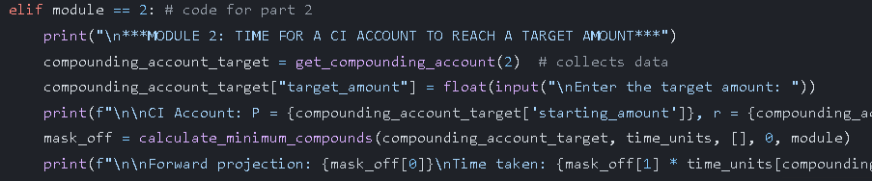
Part 1: Compare simple and Compound
Collects data from function
Splits it into different dictionaries
Uses the calculate_minimum_compounds function to calculate the amount for compounding account
Does not use a function to calculate the simple interest since this will not be reused to it doesn’t matter
Prints data

Slide 13
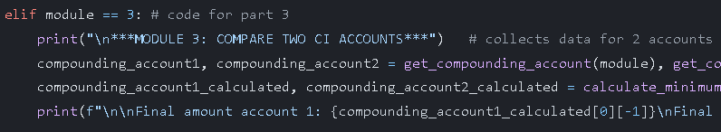
Part 2:Calculate for a Target Amount
Calls function to collect a compounding account
Then sets a target amount inside the account dictionary
Prints the User inputs for the user
Calculates the number of periods need to reach the target
Prints all the data

Slide 14
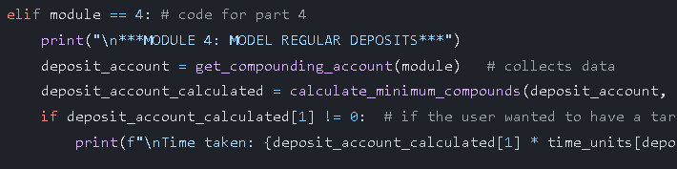
Part 3: Calculate for 2 Accounts
Gets Info from function for 2 accounts, running it twice
Calculates the final amount by reusing the same function from before
Prints all the information for both accounts

Slide 15
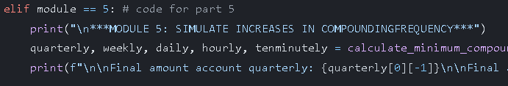
Part 4:Calculate Interest with Deposits
Calls function to collect a compounding account
The Function knows that it is part 4 and will ask for a deposit from the user
Calculates the projections and prints a table through the same calculation function
Prints the time taken if the user wanted to aim for a target, otherwise it does not print

Slide 16
Part 5: Simulate Increasing Compound Interest
Creates all the dictionary accounts with different compound times
Runs them in the calculation function and Returns the final amount to a variable
Prints the final amount for all accounts for the user to see

Slide 17
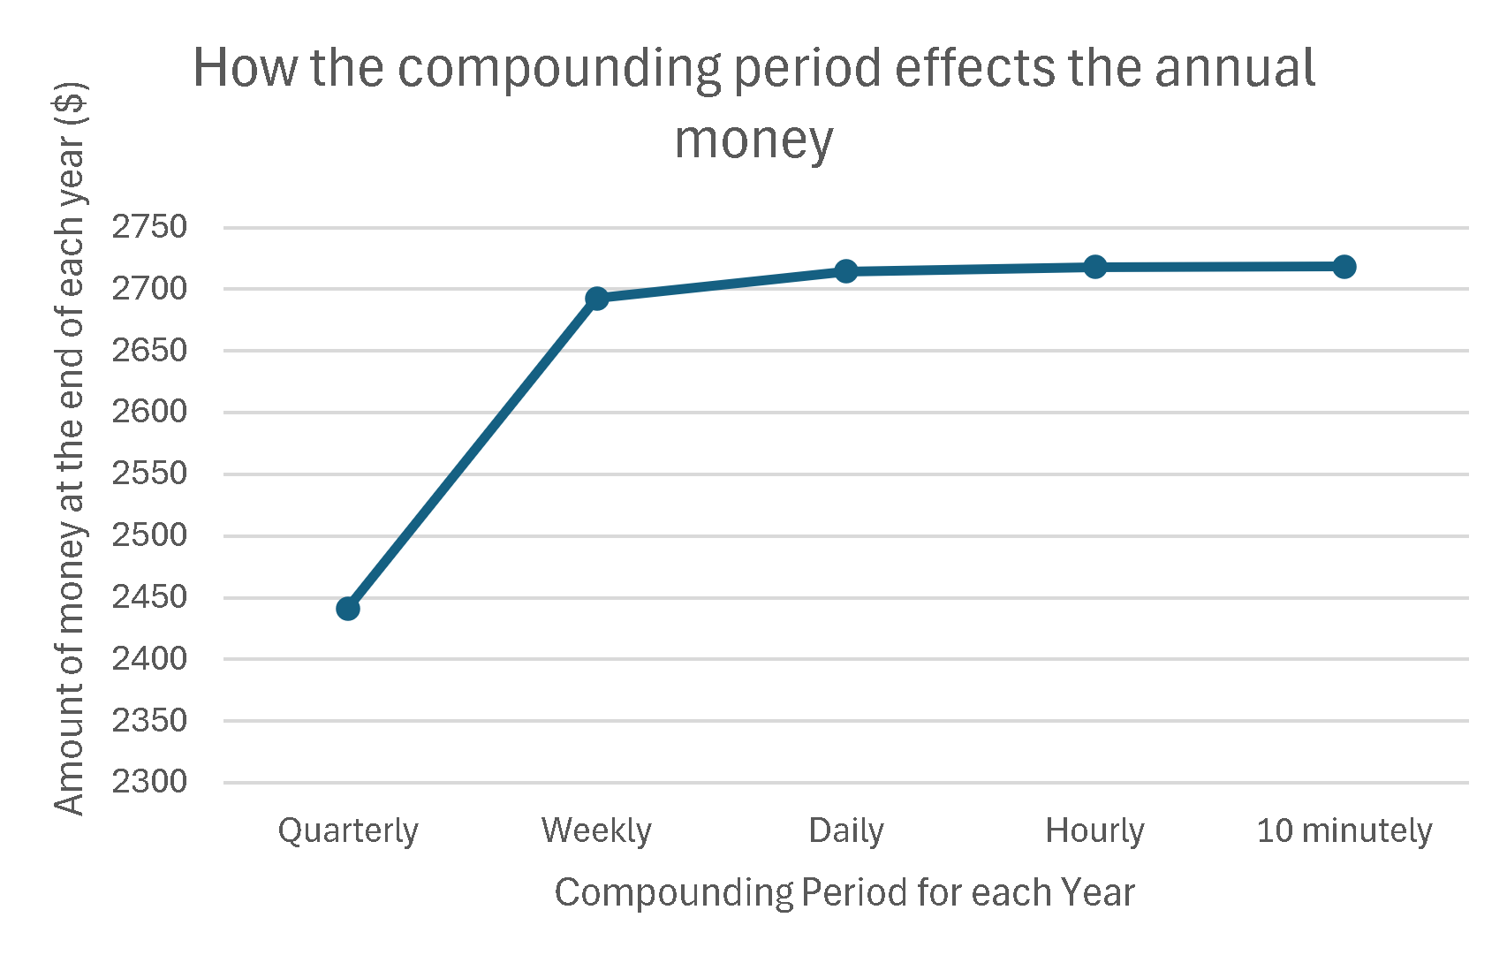


Plausible NPC
Have the same class as a player
1
Use the distance from the destination for the units to move
2
Use the gradient from the destination for the direction
3

Slide 18
Euler's Number
2.7182818284590452353602874713527
Its irrational!
1
It can be calculated as is the limit of
(1 + 1/n)^{n} as n approaches infinity, an expression that arises in the computation of compound interest, or as the sum of the infinite series
2

Slide 19
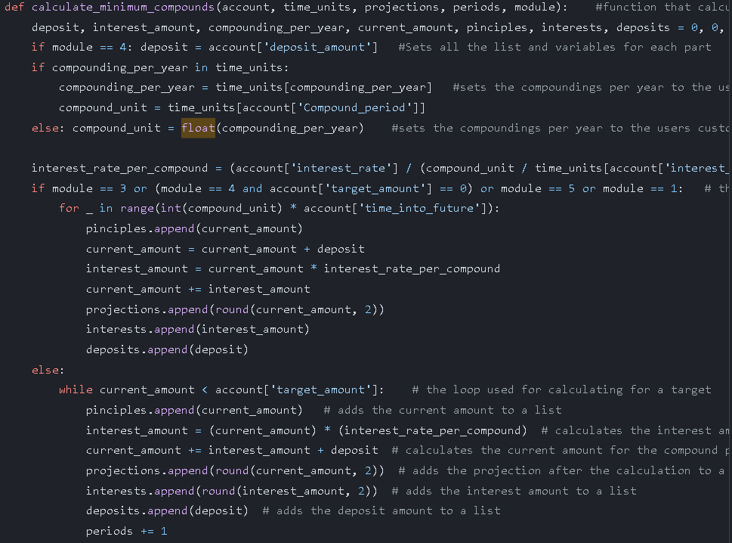
The Bomb: 1 function that does all
Sets all the variables at the start
If the module is 4, then the program will set deposit as what it is, otherwise it will be 0
Checks if the users compounding time is a set amount, if yes then it is set to that amount
If not, it stays as a number – custom compound
Sets Interest rate per compound period e.g. ( 5 / ( 12 / 1) ) / 100
First loop for a set amount, repeats for the amount of compound periods * duration e.g. 12 * 5
Repeats every compound period: sets current amount, adds deposit, could be 0
Calculates Interest then adds it to the current amount

Slide 20
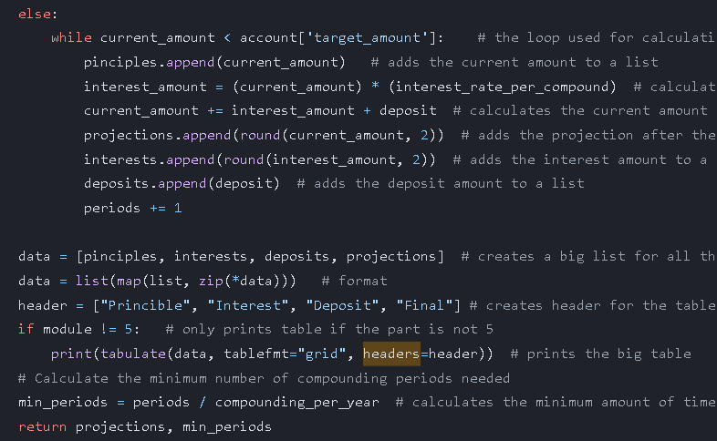
The Bomb: 1 function that does all
If the user has an aim to project to it uses the while loop
The loop repeats until the current amount is greater than the target amount, which means it met it
The inside is the same as the other loop because the calculation of interest is the same
Periods are increased by 1 to calculate the minimum amount of compounds to reach target
Uses tabulate library to print the information in a beautiful table
Returns the projections and minimum amount of compounds

Slide 21
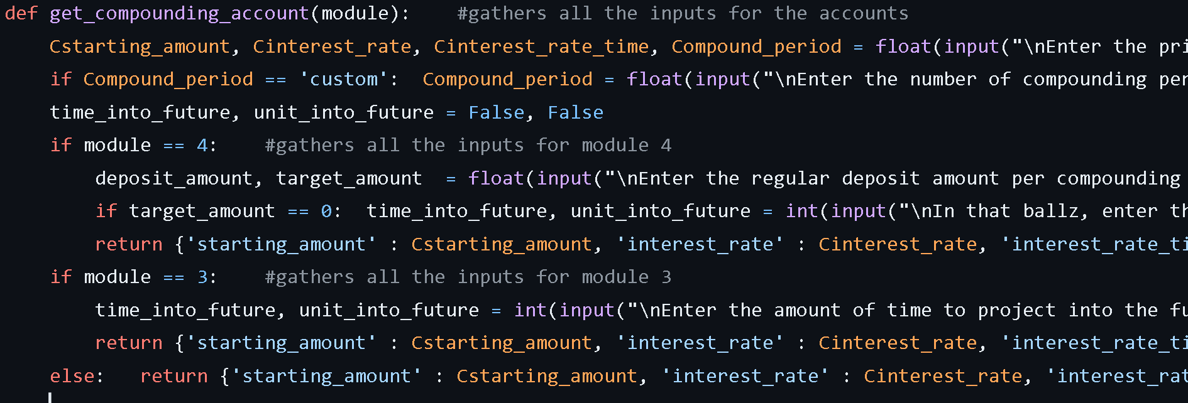
Getting Data: Get data for all compounding accounts
Sets basic compound interest variables
Sets specific ones for the part

Slide 22
Time conversion: A reusable mean
{'year' : 1, 'quarter' : 4, 'month' : 12, 'week' : 52, 'day' : 365}
(account['interest_rate'] / compounds_per_year)/ 100
Interest per compound
e.g. ( 5 / 12) * 100
e.g. (10/365) * 100
e.g. (30/1) * 100

Slide 23
code
https://github.com/thumindu007/Y9-CAT-Inv1-Thumindu-Ranasinghe

Slide 24




Tools Used
Excel
Github
Powerpoint
ChatGPT

Slide 25
Finished now🥶

